Slide 1

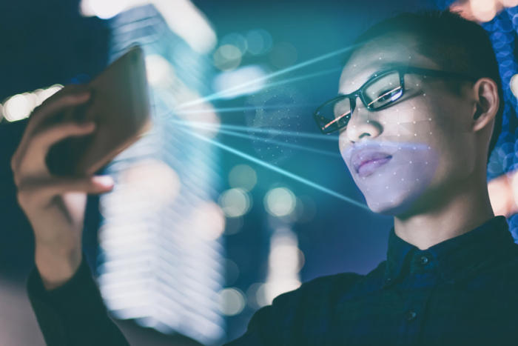

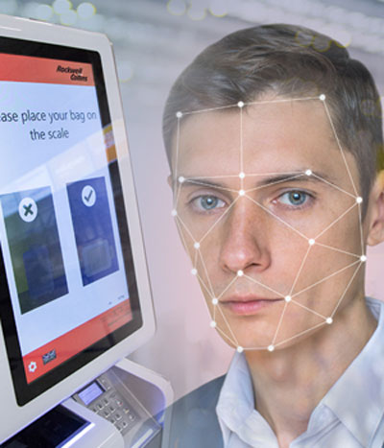
Face Recognition System
Group Members
Nirish Samant
Gouresh Khochare
Tarkeshwarnath Sahani

Slide 2
Domain
To detect facial expression based on Deep Convolutional-Neutral-Network.
This topic will develope using Machine Learning which consists 80% training and 20%testing.
Neutral Network means a computer system modelled on the human brain and nervous system.
CNNs(Convolutional-Neutral-Network) specifically are inspired by the biological visual cortex.

Slide 3
Keywords
Facial Expressions
Machine Learning
Deep Learning
Convolutional-Neural-Network

Slide 4
Face Recognition
Early in the 1990s, Picard predicted that Affective Computing would be an important directio So far, the deep learning algorithm has achieved good performance in speech recognition,collaborative filtering, handwriting recognition, computer vision and many other fields n for future artificial intelligence research .
In 1971, the American psychologist Ekman and Friesen defined seven categories of basic facial expression, which are Happy, Sad, Angry, Fear, Surprise, Disgust and Neutral .
In 1991, A.Pentland and K.Mase held the first attempt to use optical flow method to determine the direction of movement of facial muscles. Then, they extracted the feature vectors to achieve four kinds of automatic expression recognition including Happy, Angry, Disgust, Surprise and got nearly 80% accuracy.

Slide 5
Hinton suggested that the neural network with multiple hidden layers had good ability for learning characteristics. It can improve the accuracy of prediction.
when Hinton and his students used a deeper Convolutional Neural Network to reach the optimal results in the world on ImageNet in 2012. Since then, more attention has been paid on CNN based image recognition.

Slide 6
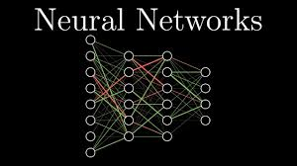

Slide 7
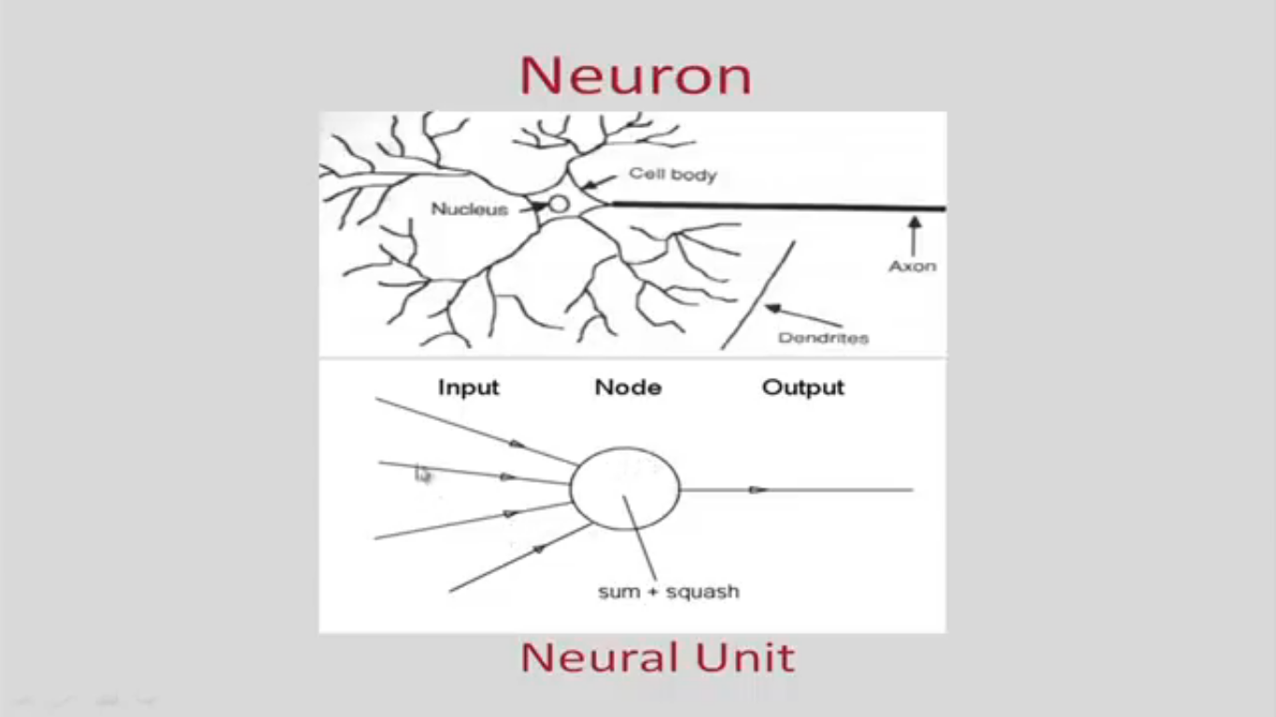
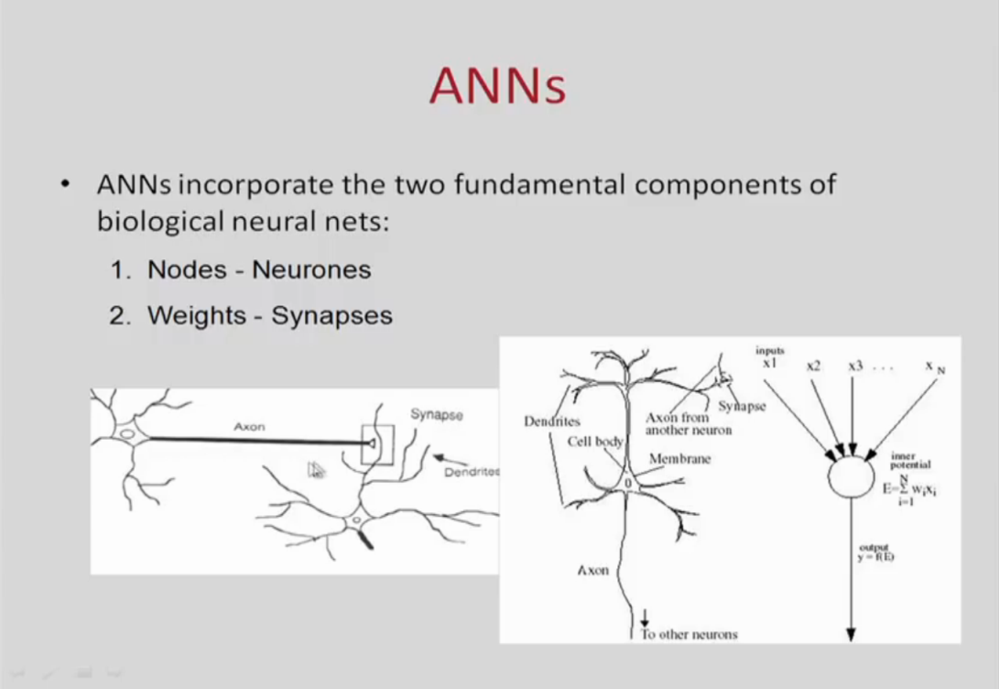
Biological Neuron

Slide 8
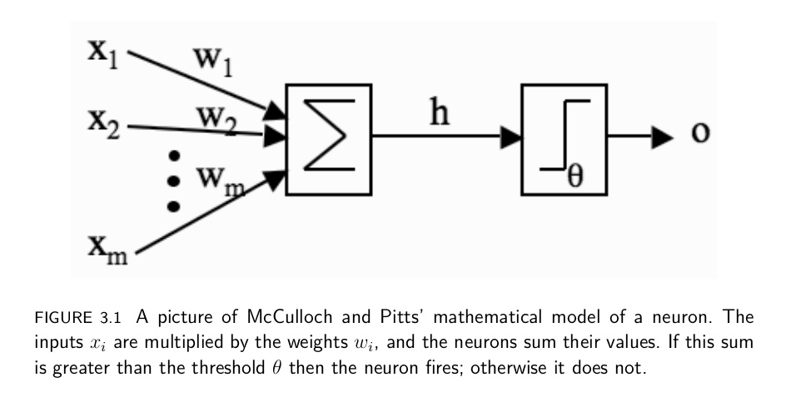
McCulloch and Pitts Neurons

Slide 9
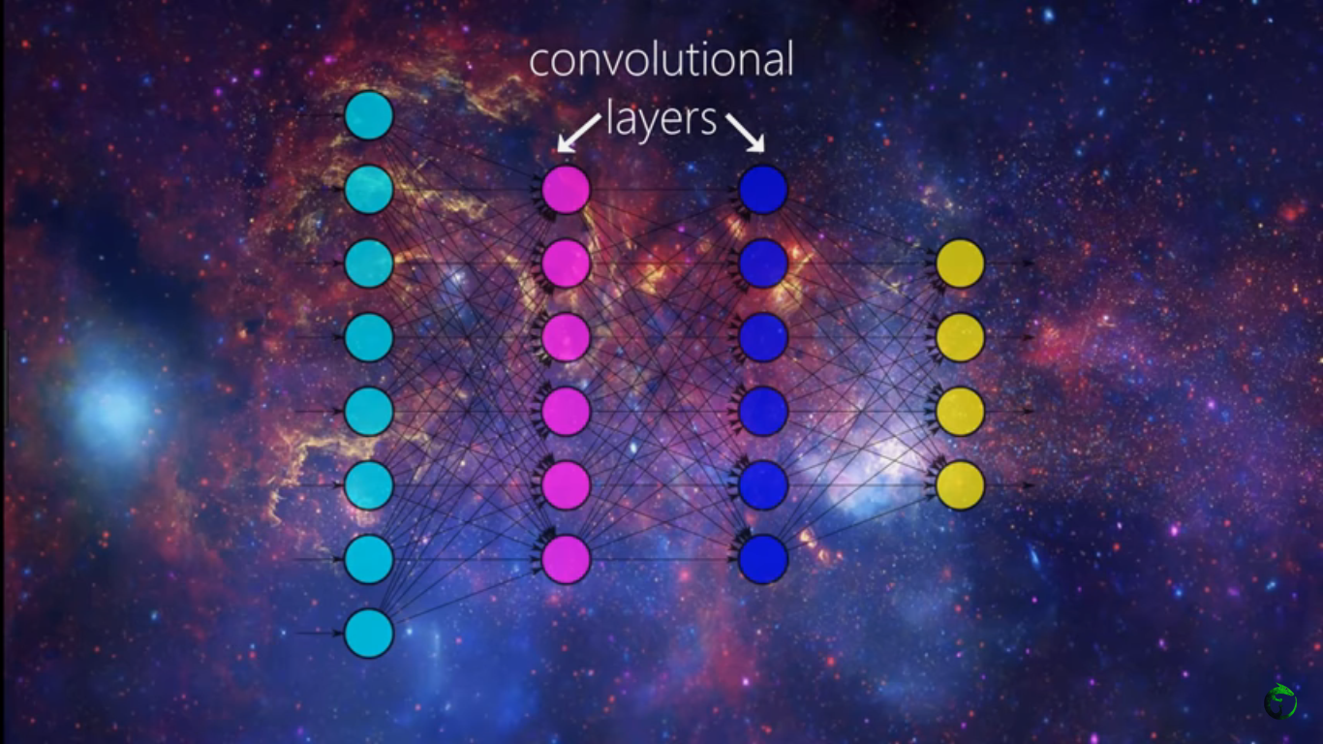

Slide 10
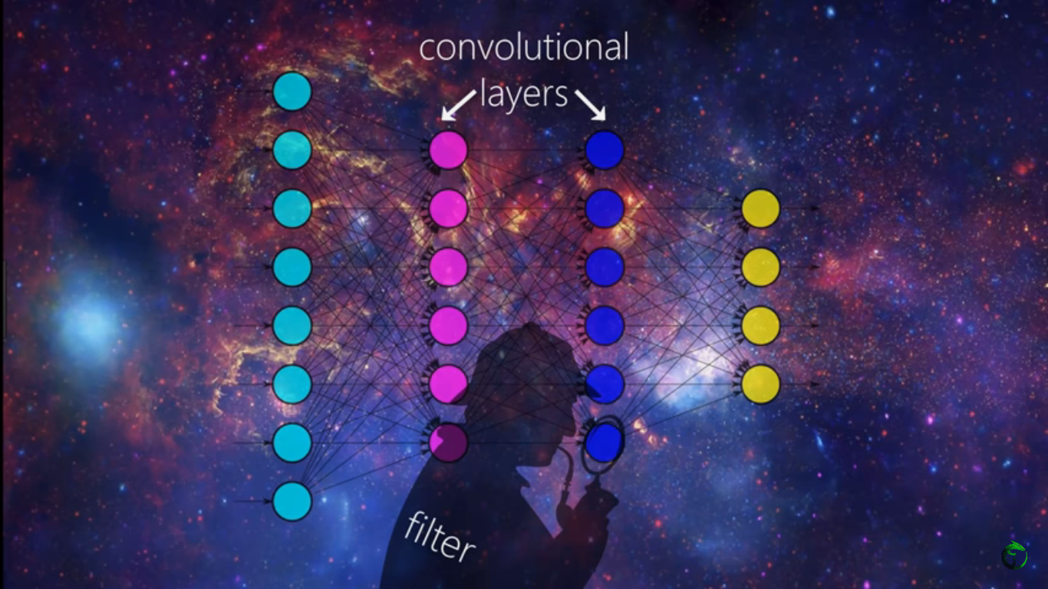

Slide 11
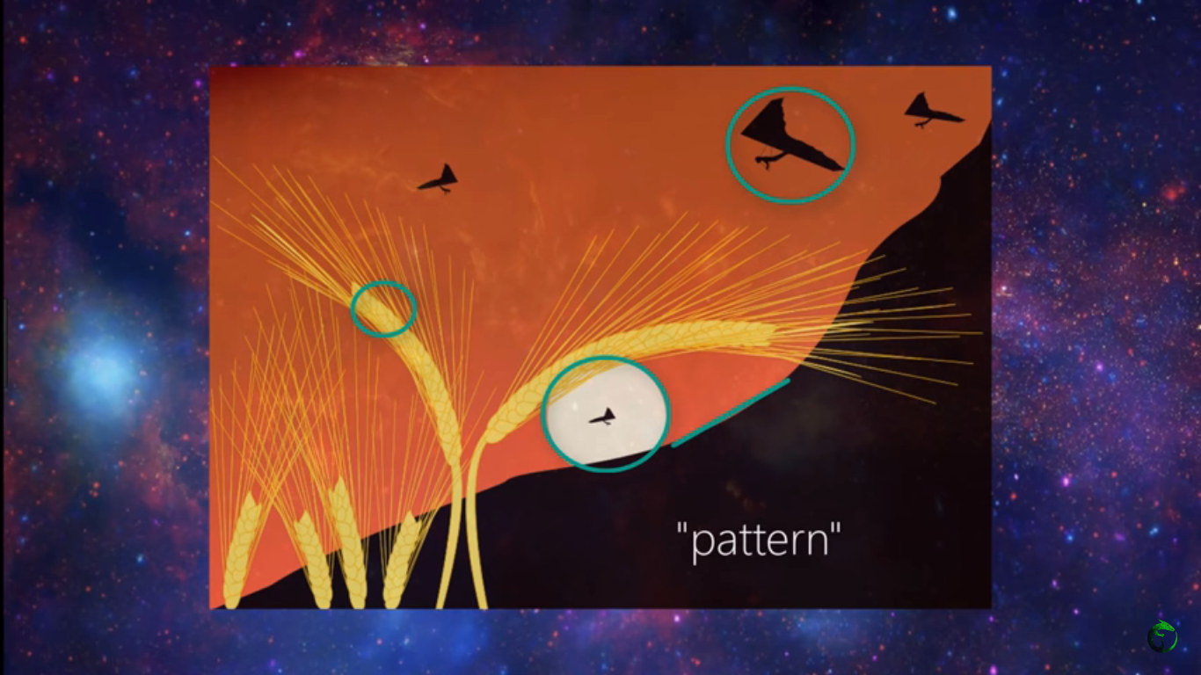

Slide 12
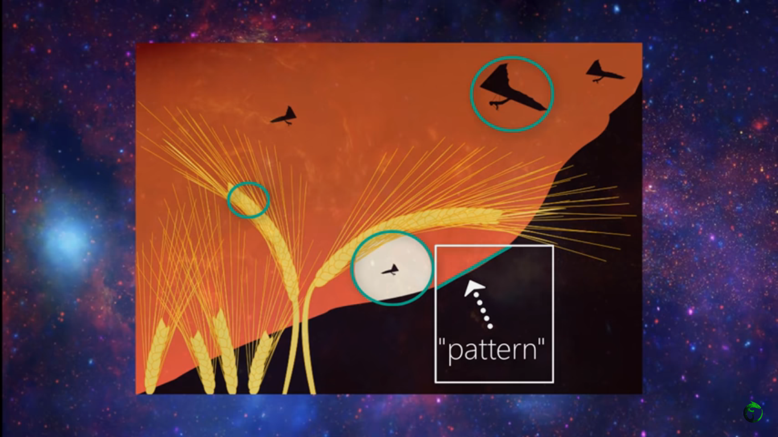

Slide 13
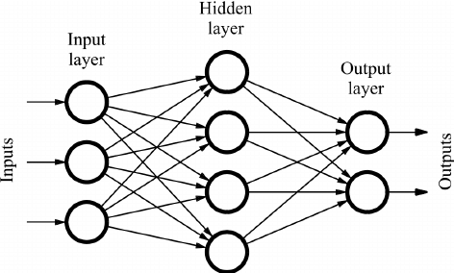

Feed Forward Neural Networks

Slide 14
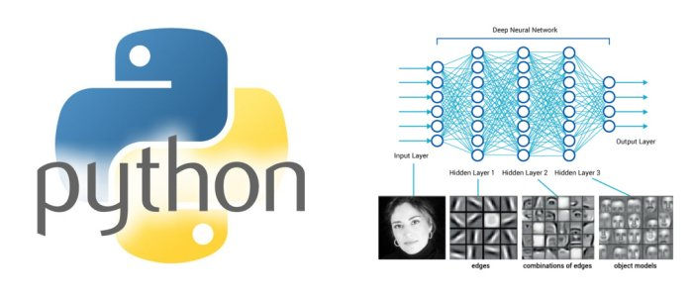

Slide 15
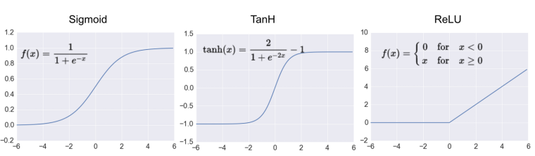
Activation Functions

Slide 16

Python
Python is a general purpose programming language started by Guido van Rossum, which became very popular in short time mainly because of its simplicity and code readability. It enables the programmer to express his ideas in fewer lines of code without reducing any readability.
Smart developers are choosing Python as their go-to programming language for the that make it particularly suitable for machine learning and deep learning projects.
Python's simple syntax and readability promote rapid testing of complex algorithms.

Slide 17

Open CV
OpenCV (Open source computer vision) is a library of programming functions mainly aimed at real-time computer vision.

Slide 18
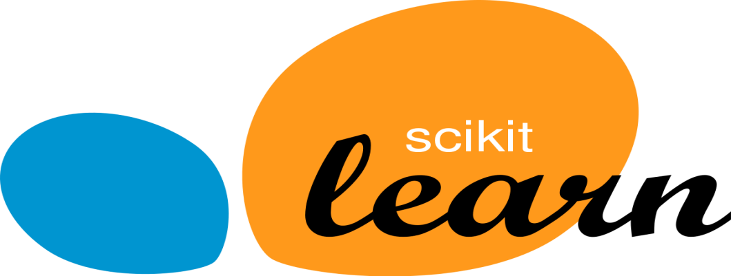
Scikit-learn
Scikit-learn (formerly scikits.learn) is a free software machine learning library for the Python programming language. It features various classification, regression and clustering algorithms including support vector machines, random forests, gradient boosting, k-means and DBSCAN, and is designed to interoperate with the Python numerical and scientific libraries NumPy and SciPy.

Slide 19

Tensor Flow
TensorFlow is an open-source software library for dataflow programming across a range of tasks. It is a symbolic math library, and is also used for machine learning applications such as neural networks.

Slide 20


